Slide 1
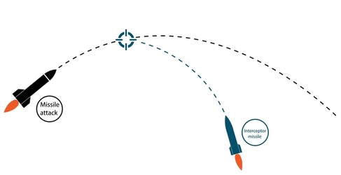
Control Theory
From
Mathematical Optimization and Economic Theory
Jacob Wyngaard

Slide 2
Background
  A control problem seeks to maximize an objective functional which depends upon the state and control variables of a dynamic system over a period of time
  The dynamic system evolves in time through equations of motion, which depend on the state and control variables

Slide 3
State Variables
  Words

Slide 4
Control Variables
  Words

Slide 5
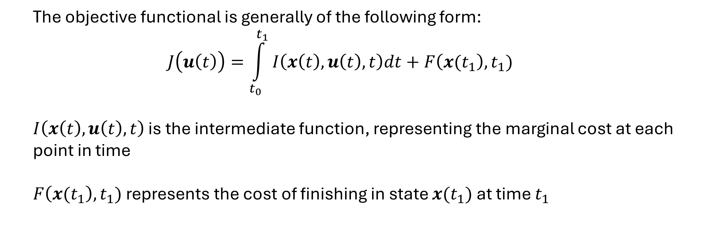
Objective Functional
  The objective functional is generally of the following form:
  $$J\left(u\left(t\right)\right)=\int_{t_{0}}^{t_{1}}{I\left(x\left(t\right),u\left(t\right),t\right)dt}+F\left({x(t}_{1}\right),t_{1})$$
  $I\left(x\left(t\right),u\left(t\right),t\right)$ is the intermediate function, representing the marginal cost at each point in time
  $F\left({x(t}_{1}\right),t_{1})$ represents the cost of finishing in state ${x(t}_{1})$ at time $t_{1}$

